Slide 1
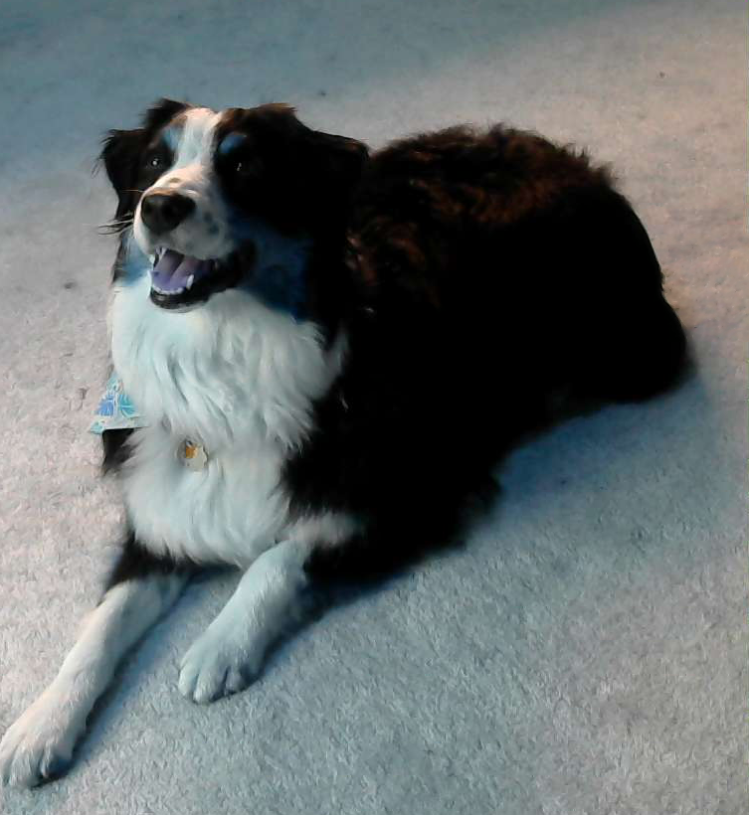
Good Boiii
Valerie Chau, Ethan Duncan,
Heather Pieszala, Rishika Pulvender

Slide 2
Background

Slide 3
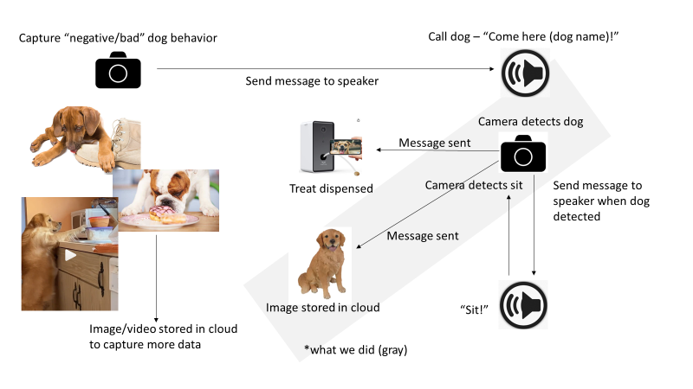
Product Vision

Slide 4
Data

Slide 5
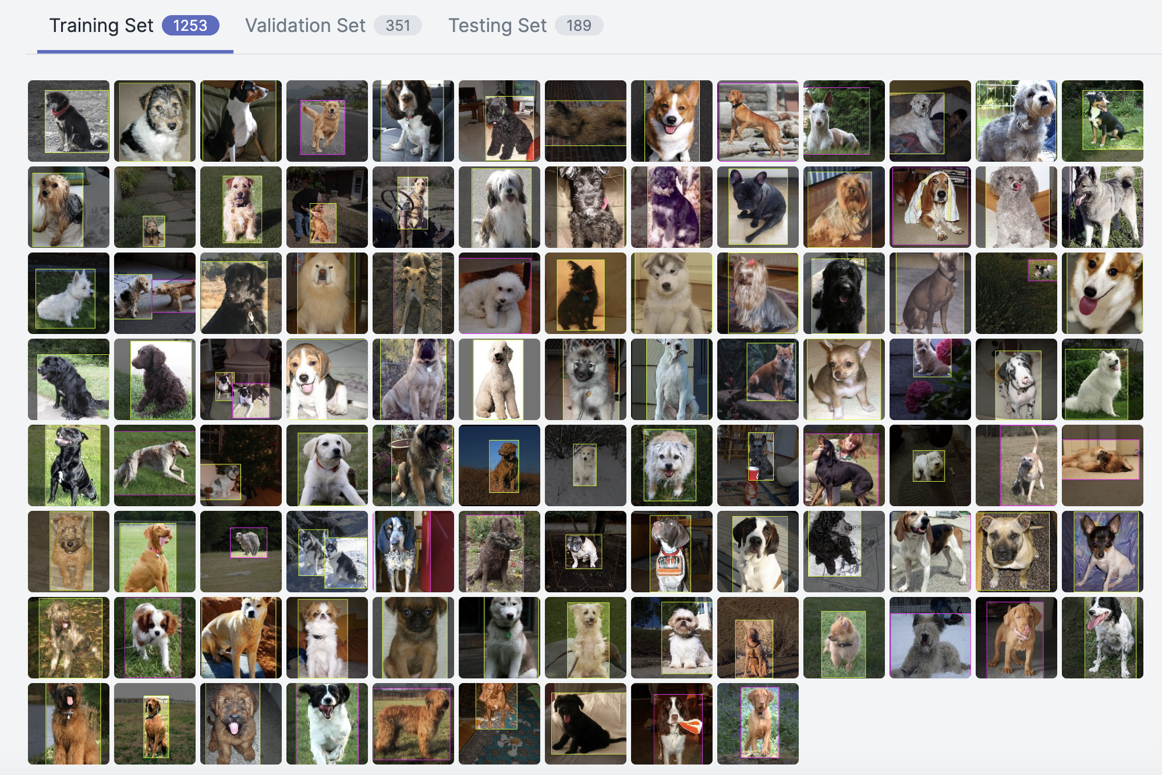
Data Gathering
Goal: “Good” vs “Bad” behavior dataset
Image Gathering
Stanford Dog Detection - collected for fine-grain, dog image categorization
Consists of 20,000 images, 120 dog breeds
Roboflow: Computer vision framework for data collection, preprocessing, and model training techniques

Slide 6
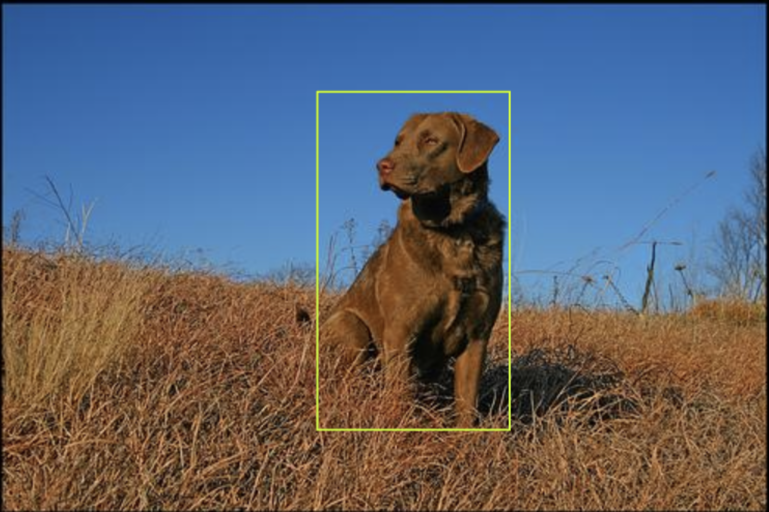
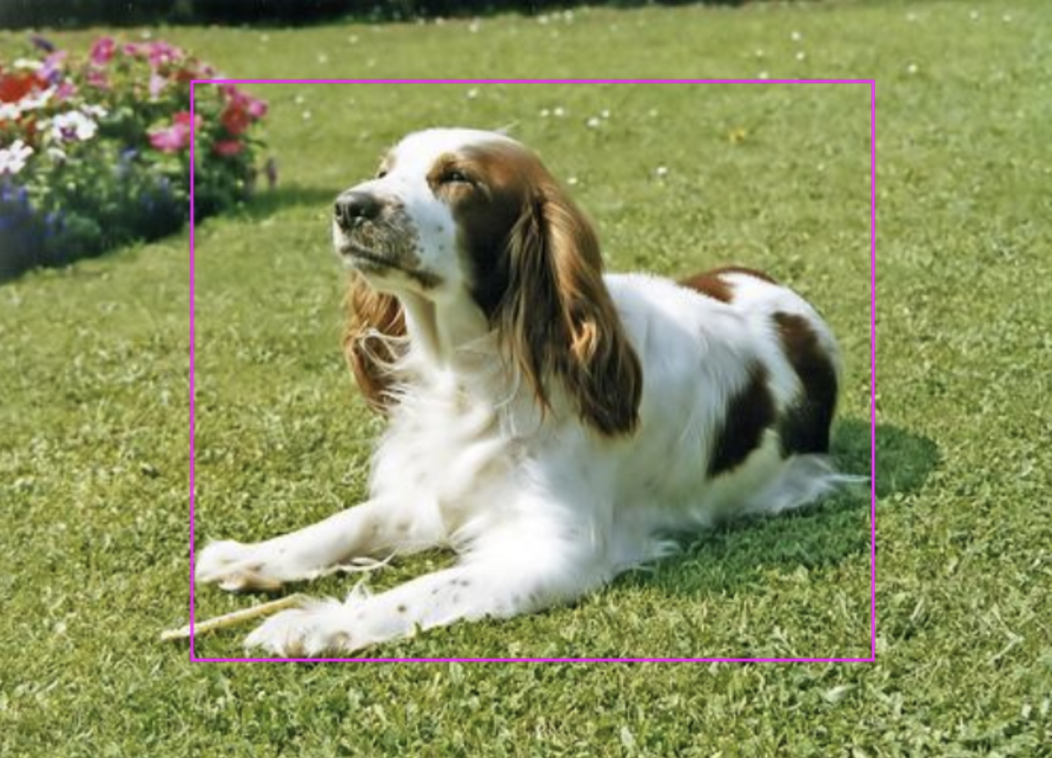
Data Creation
Image Labeling
Classes: ‘sit’ vs. ‘other’
Selected 5-10 for each class from each breed
Base dataset - 1792 images
Base dataset permutations
Base image augmentation
Base image augmentation with bounding box augmentation
Base image augmentation with bounding box augmentation & grayscale
mAP (mean Average Precision) was two times higher in base augmentation when compared to the other two (87.4%, 48.8%, 42.6%).
Train: 3.8K images (87%)
Validation: 349 images (8%)
Test: 189 images (4%)
sit
other

Slide 7
Models & Results

Slide 8
Model Experimentation
RoboFlow
OpenAI CLIP
ResNet34
EfficientDet
OpenAI released CLIP: Contrastive Language-Image Pre-Training
CLIP is among one of the most efficient models with an accuracy of 41% of 400 million images
Results: 1.5% accuracy
34 layered ResNet architecture which uses deep and hidden layers making it a state of the art classification model.
Error: ImageDataBunch object being pulled from fastai
Image detection model based off of EfficientNet that uses CNNs
Main feature: uniformly scales images, backbone, and net so that accuracy is balanced with efficiency
Monk Detection GitHub → lower loss
Yet-Another-EfficientDet GitHub → better classification
Notes:
What the different models are - compare & contrast

Slide 9
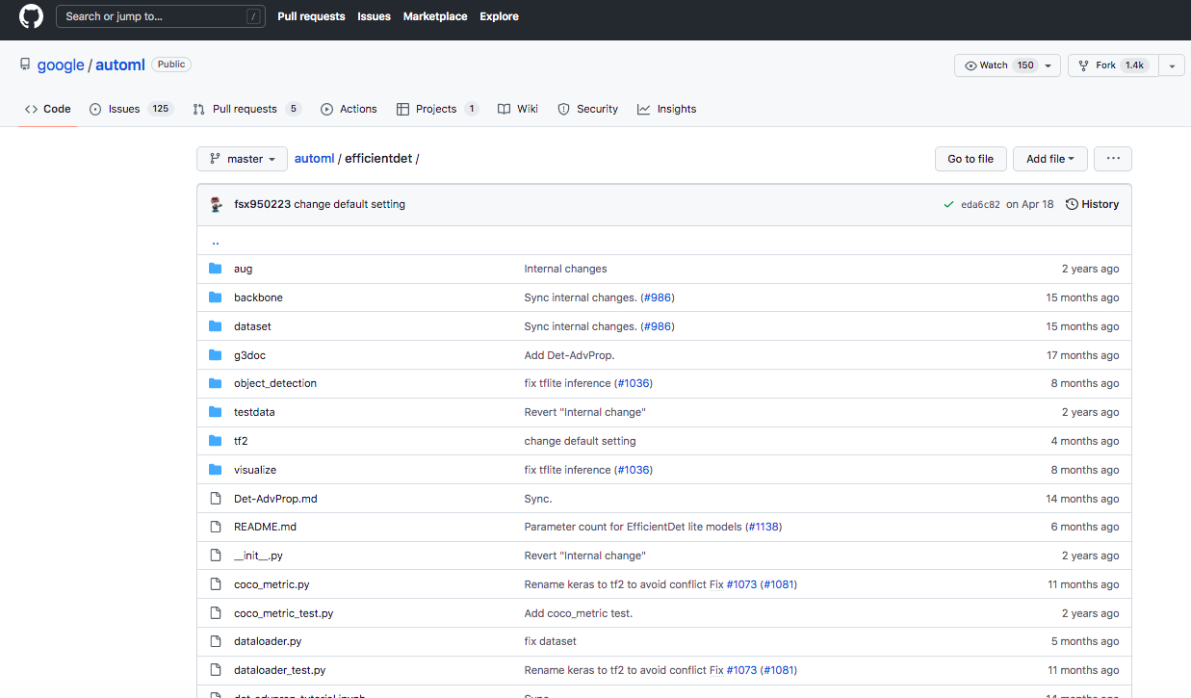
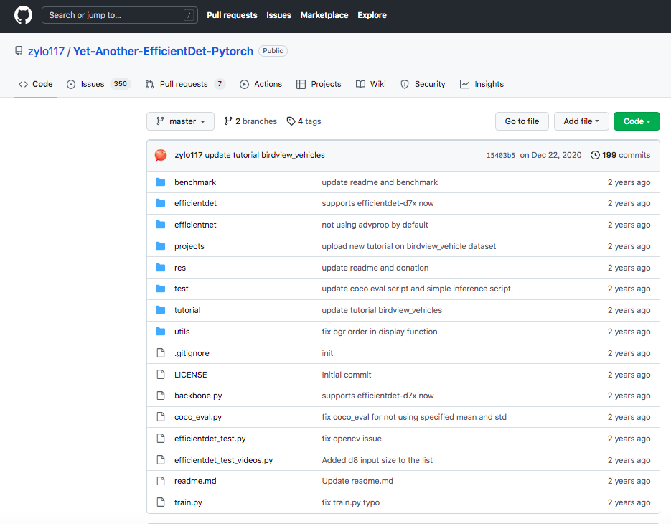
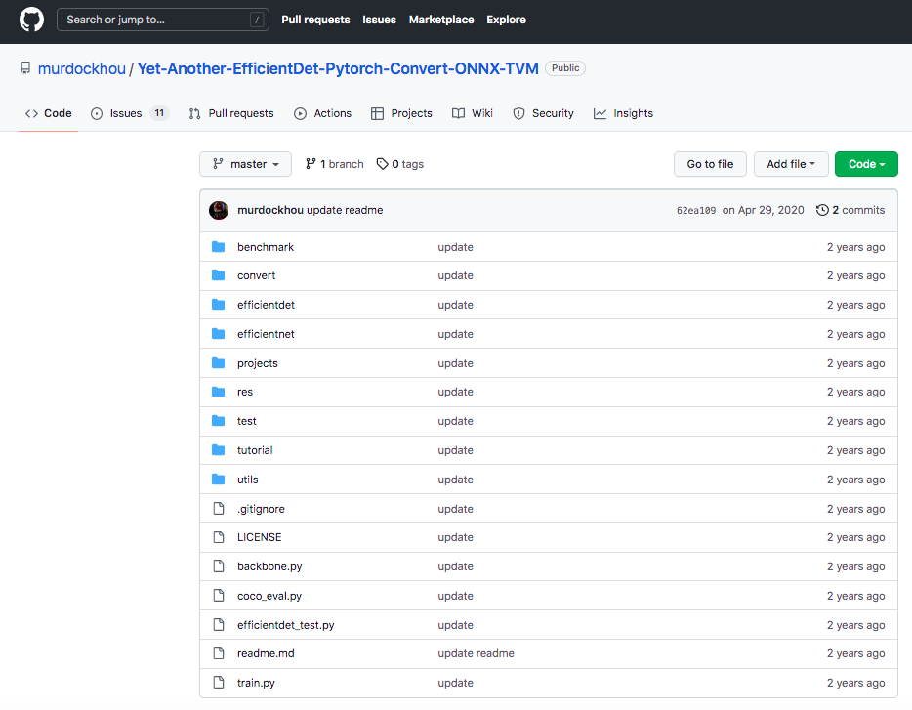
EfficientDet
Official Version (Google)
Modified Versions: ‘Yet-Another-EfficientDet-Pytorch Repo to build models
+Converter

Slide 10
EfficientDet - Training
Pretrained Weights: | EfficientDet-d0/d1/d2
COCO Anchors: | anchors_scales: '[2 ** 0, 2 ** (1.0 / 3.0), 2 ** (2.0 / 3.0)]' anchors_ratios: '[(1.0, 1.0), (1.4, 0.7), (0.7, 1.4)]'
Hyperparameter Adjustments: | 30-epochs with head only = TRUE LR: 0.001 120 epochs with head only = FALSE LR: 0.0005
Val. Epoch: 149/150. Classification loss: 0.45954. Regression loss: 0.87002.
Total loss: 1.32956

Slide 11
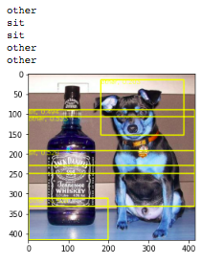
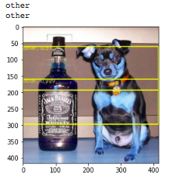
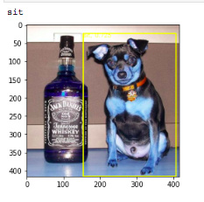
EfficientDet - Evaluation
 | Latest | Example 1 | Example 2
Average Precision (AP) @[ IoU=0.50:0.95 ] | 0.60819 | 0.58900 | 0.82981
Average Recall (AR) @[ IoU=0.50:0.95] | 0.68066 | 0.69763 | 0.66984
Latest
Example 1
Example 2

Slide 12

Results Explained
Precision: number of instances that are relevant, out of the total instances the model retrieved
Recall: number of instances which the model correctly identified as relevant out of the total relevant instances
Source

Slide 13
YoloV5 - Training
Pretrained Weights: | YoloV5 Weights
Hyperparameter Adjustments: | Original: (Epochs: 10, Batch Size: 32, LR: 0.001) Modified v1: (Epochs: 20, Batch Size: 16, LR: 0.0005) Modified v2: (Epochs: 200, Batch Size: 10, LR: 0.001)

Slide 14
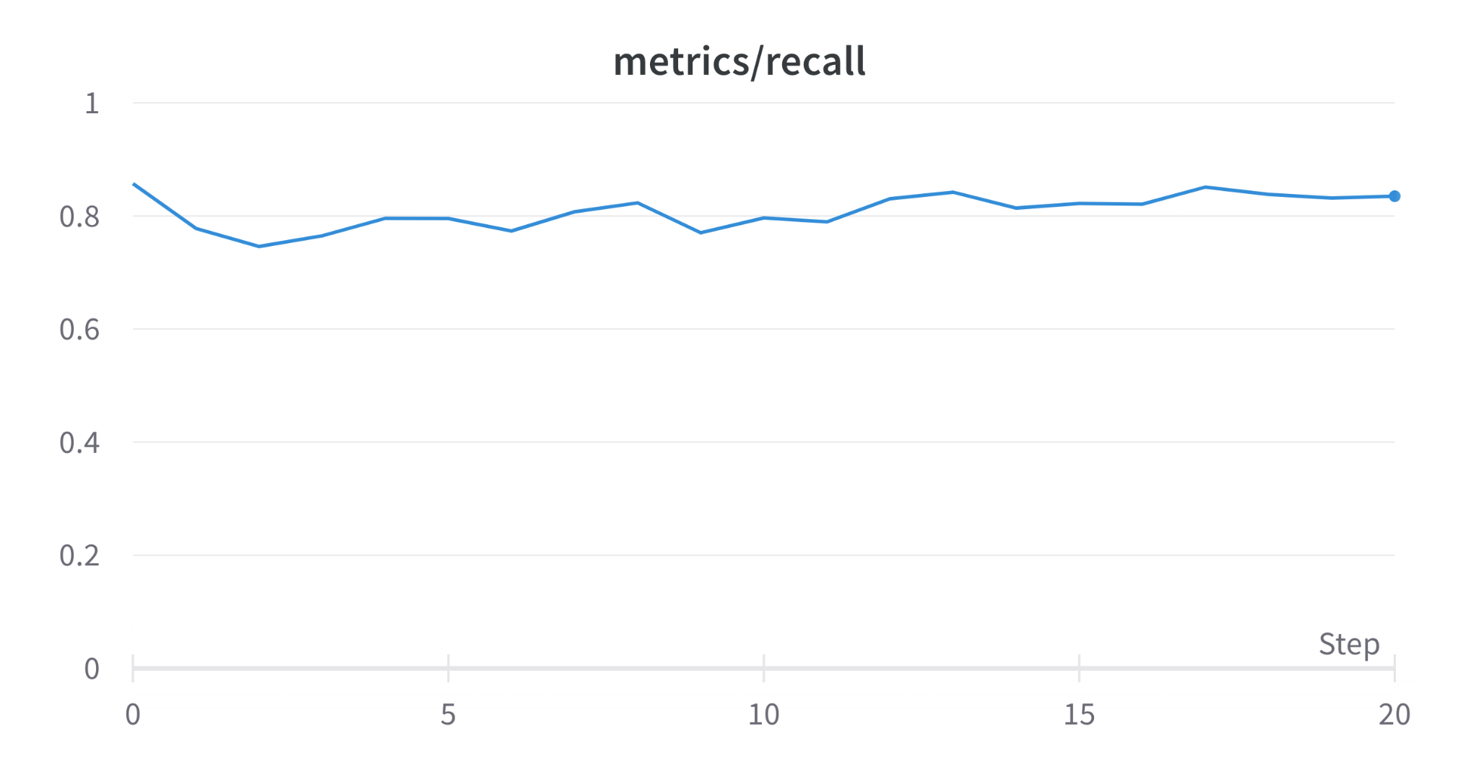
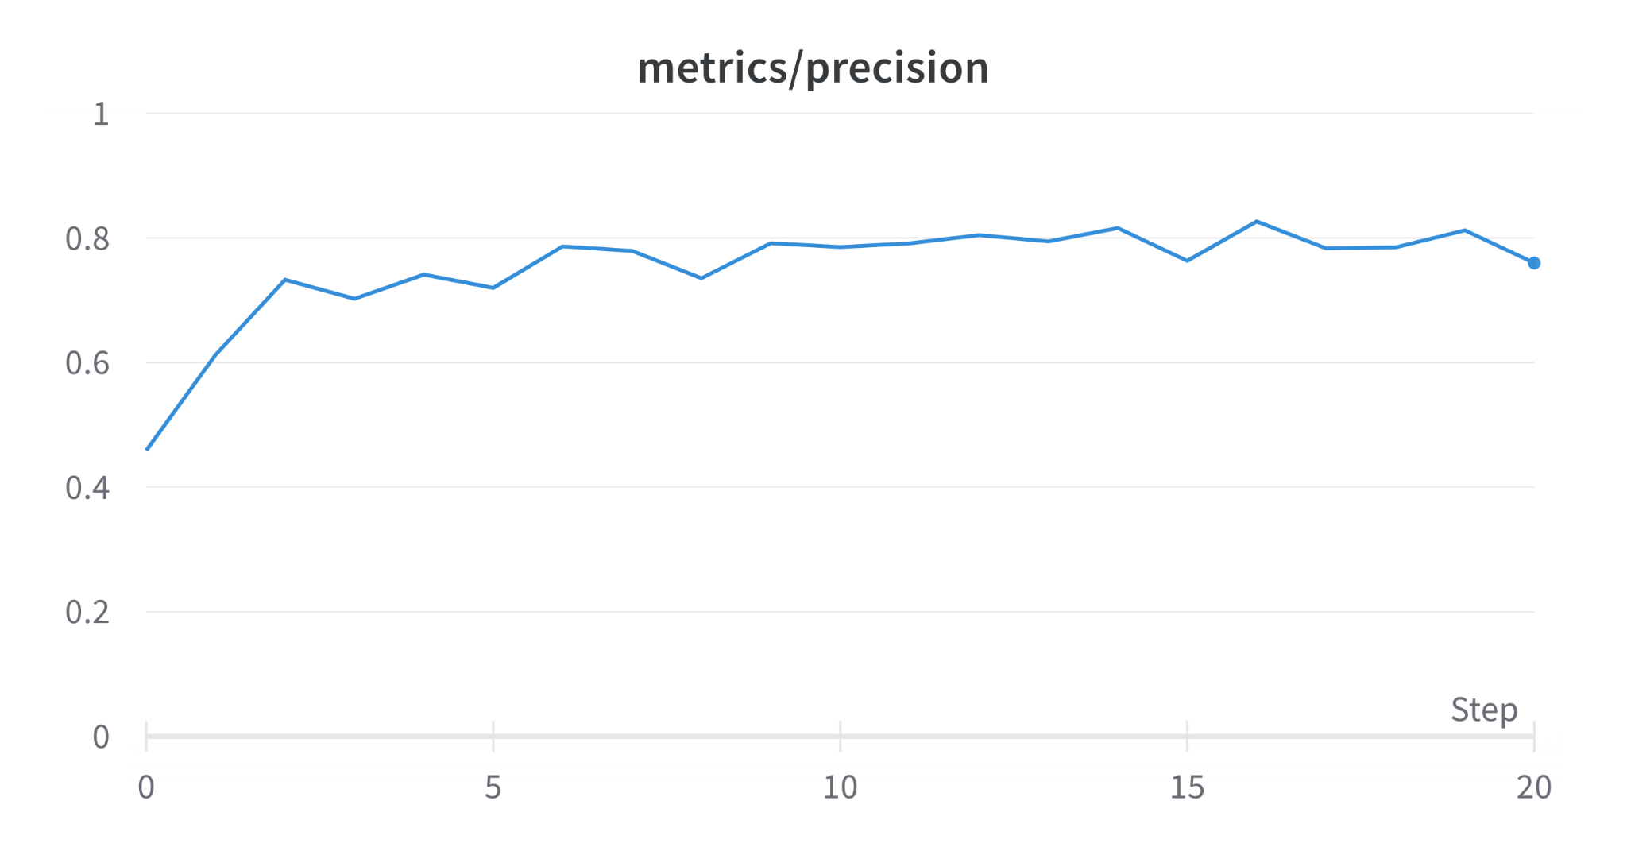
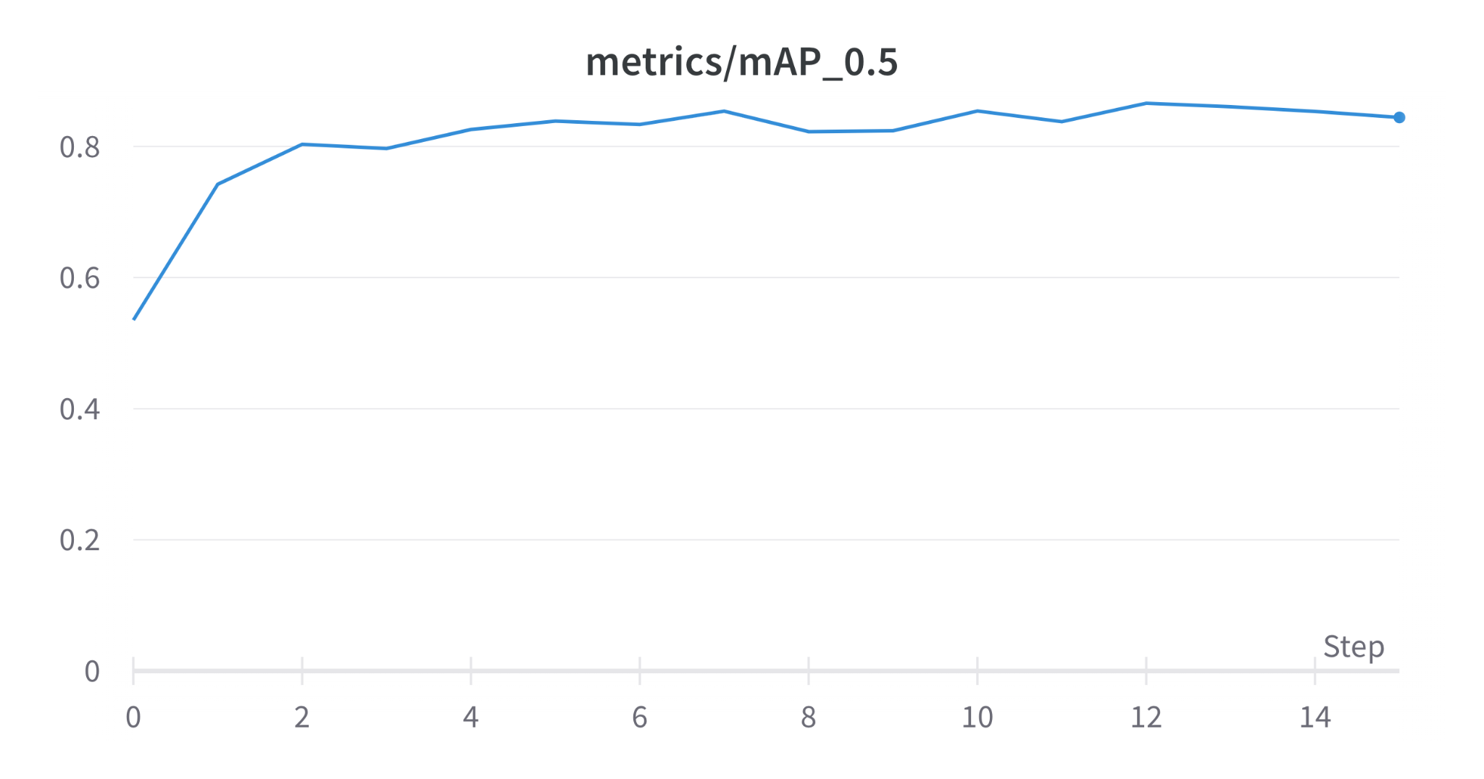
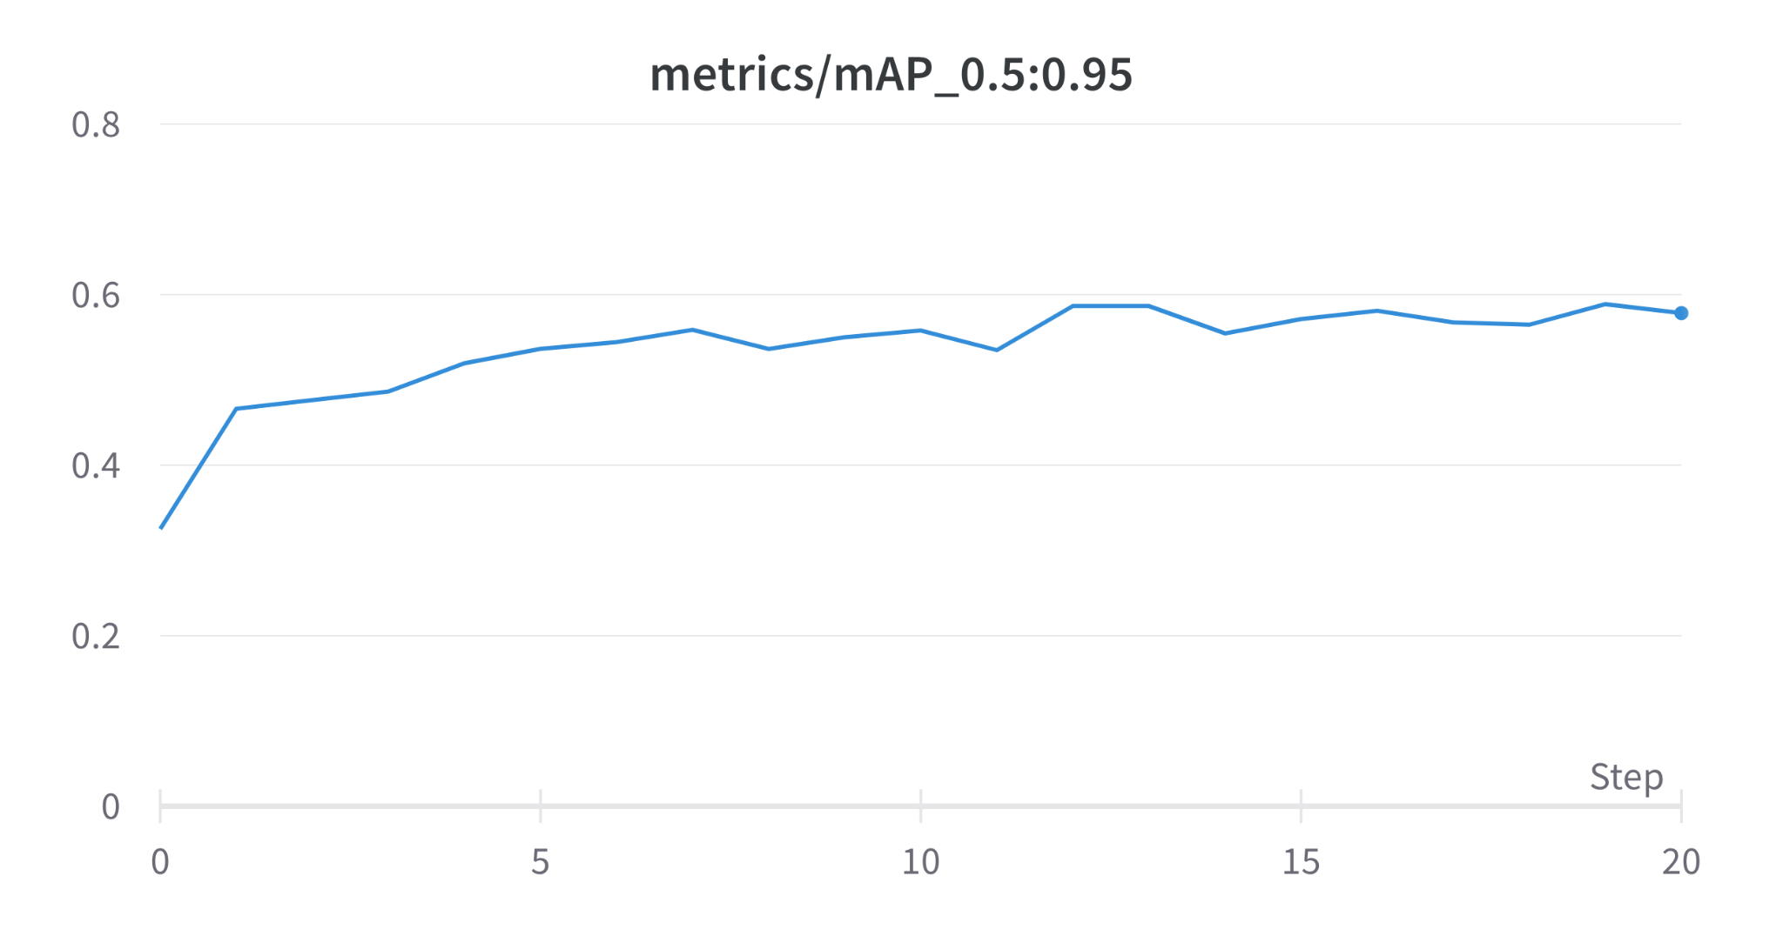
YoloV5 (v1 Results)- Precision, Recall and mAP

Slide 15
YoloV5 (v1 Results)- Evaluation
Class | Images | Labels | Precision | Recall | mAP@0.5 | mAP@0.5:0.95
all | 349 | 370 | 0.837 | 0.854 | 0.9 | 0.645
other | 349 | 188 | 0.849 | 0.851 | 0.9 | 0.634
sit | 349 | 182 | 0.825 | 0.857 | 0.901 | 0.655

Slide 16
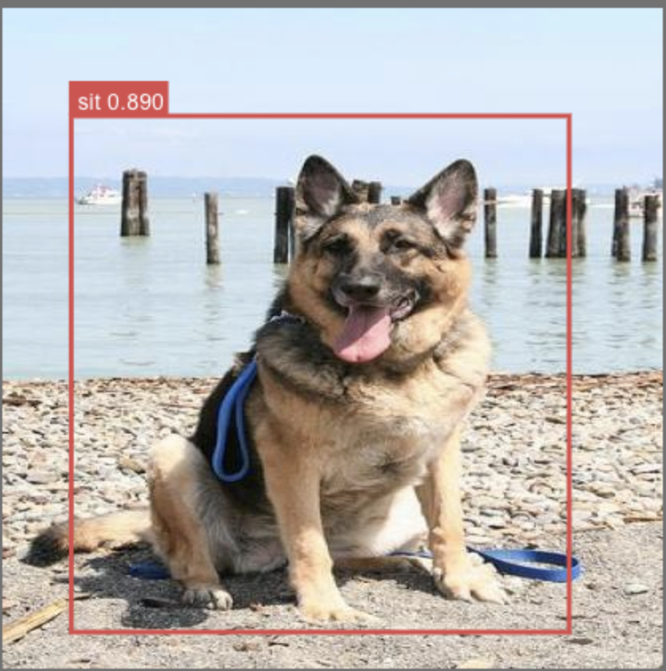
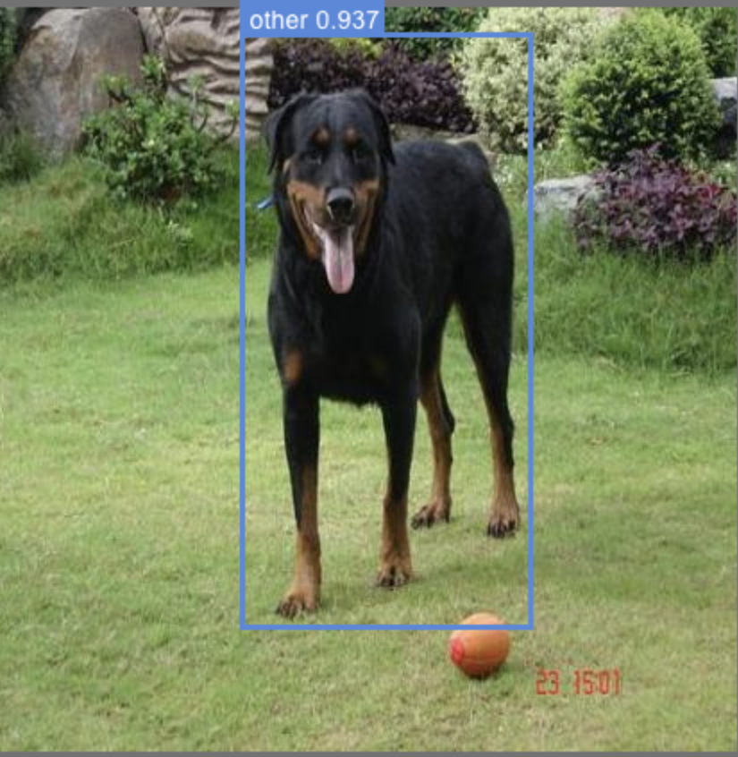
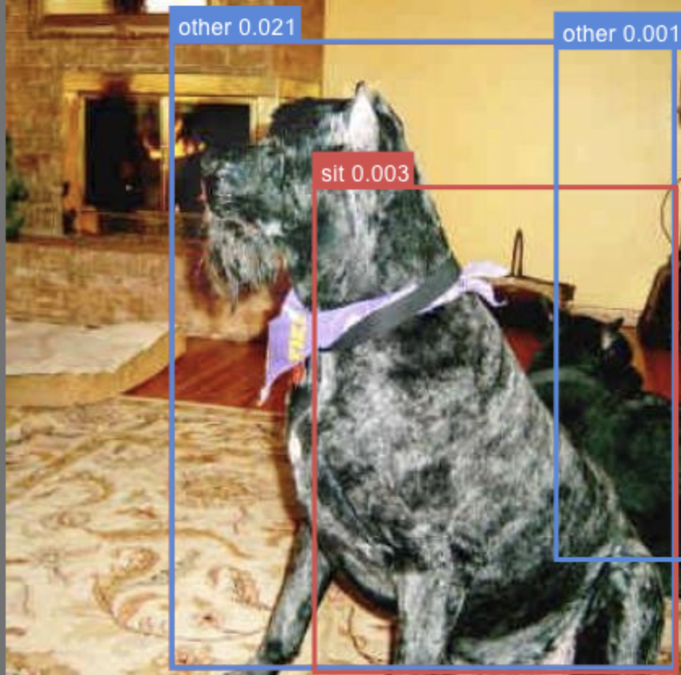
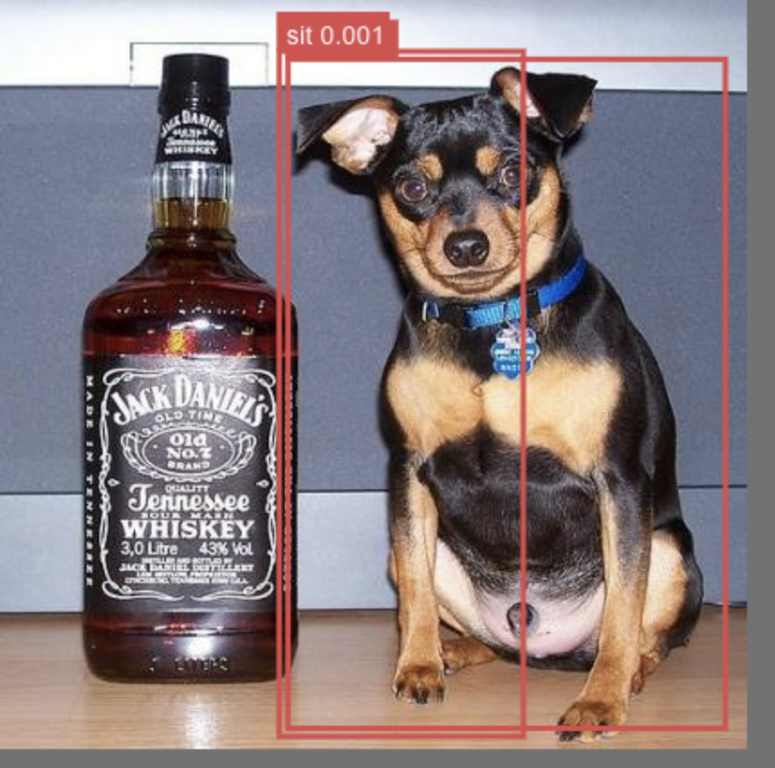
YoloV5 (v1 Results)- Evaluation cont.
Good Detections
Bad Detections

Slide 17
Pipeline

Slide 18
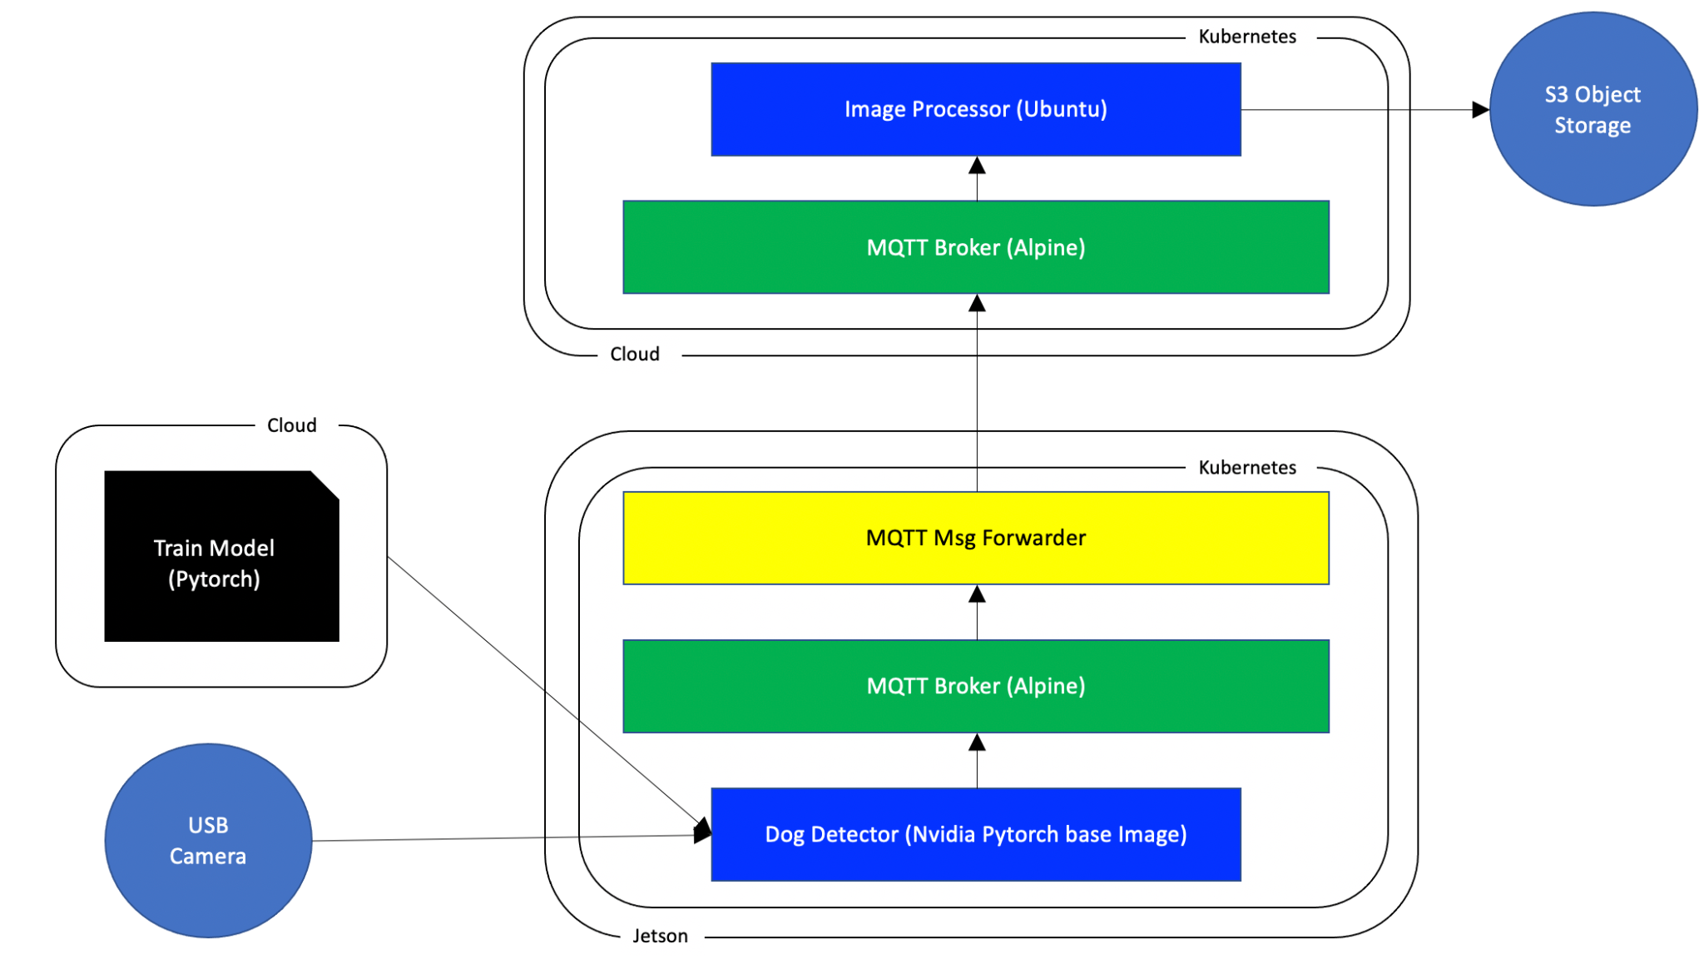
Architecture

Slide 19
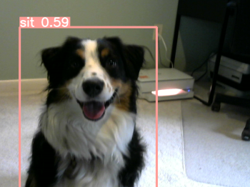
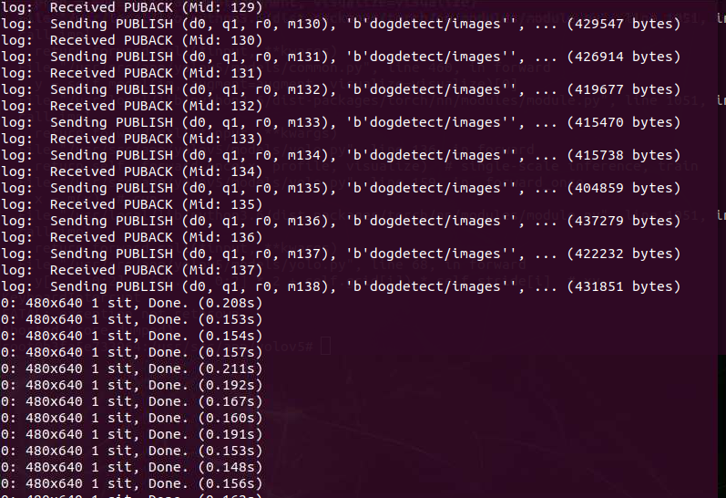
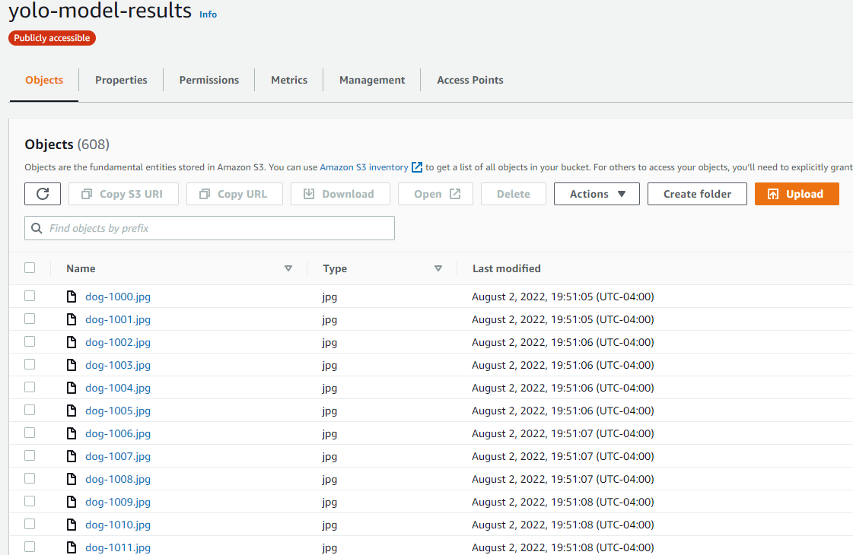
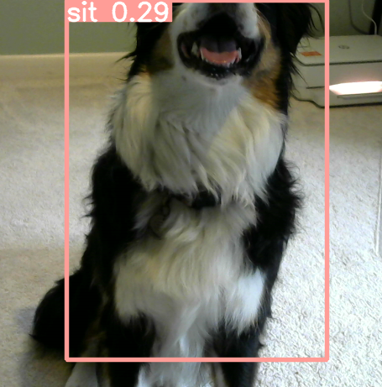
Pipeline Results

Slide 20

Demo

Slide 21
Challenges

Slide 22
Issues Along the Way
Deciding which model architecture
Creating Custom Weights + Exporting Desired Weights Format
Finding Compatible Weights + Pipeline
Deploying on Cloud
Kubernetes Update
Raising Model Accuracy
Time Constraints

Slide 23
Next Steps…

Slide 24

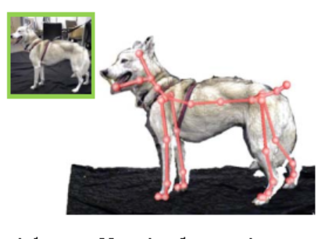
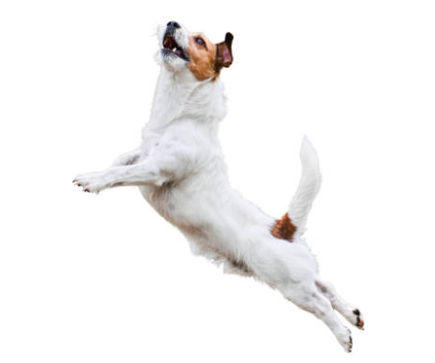
Recommendations
More Dogs or Varied Data
Pose Estimation Techniques
Additional Poses
IMPROVE
IMPROVE
EXPAND

Slide 25
What’s Next?

Slide 26
References
Aditya Khosla, Nityananda Jayadevaprakash, Bangpeng Yao and Li Fei-Fei. Novel dataset for Fine-Grained Image Categorization. First Workshop on Fine-Grained Visual Categorization (FGVC), IEEE Conference on Computer Vision and Pattern Recognition (CVPR), 2011. [pdf]
Cavey, Tom & Stock, Jason. “Who's a Good Boy? Reinforcing Canine Behavior in Real-Time using Machine Learning.” Cornell University: arxiv. January 21, 2022. Link: [2101.02380v2] Who's a Good Boy? Reinforcing Canine Behavior in Real-Time using Machine Learning (arxiv.org)
Solawetz, Jacob. “How to Try CLIP: OpenAI’s Zero-Shot Image Classifier.” Roboflow Blog, Roboflow Blog, 8 Jan. 2021, https://blog.roboflow.com/how-to-use-openai-clip/.

